Slide 1



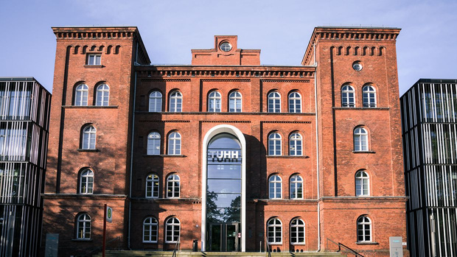
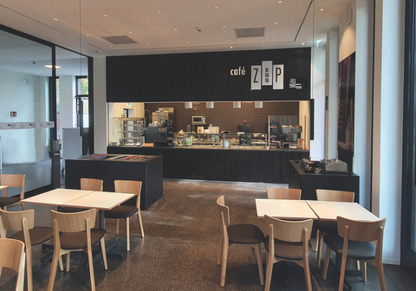


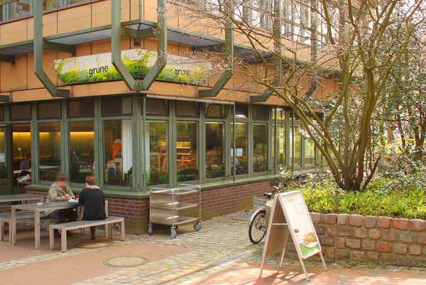
COFFEE HABITS ON CAMPUS
Presented by
Youssef, Valentin and Asad

Slide 2
  Objectives
  Investigate students’ coffee consumption habits
  Understand preferences by location, type, and reason
  Explore how semester and other factors relate to coffee choices
  Dataset Summary
  Data points: 113 students
  Time of data collection: 10:00 – 11:00
  Data collection methods: In-person survey and online form
  Location: In front of campus shop
  Target audience: Mainly students

Slide 3
  Survey Questions
  How many semesters have you studied at TUHH?
  Where on campus do you usually buy coffee from
  Why do you buy coffee from that location
  What kind of coffee do you usually buy
  On a scale from 1 to 5, how would you rate the coffee you buy
  Our Hypothesis
  The longer a student has been at the TUHH, the higher they will rate their coffee

Slide 4
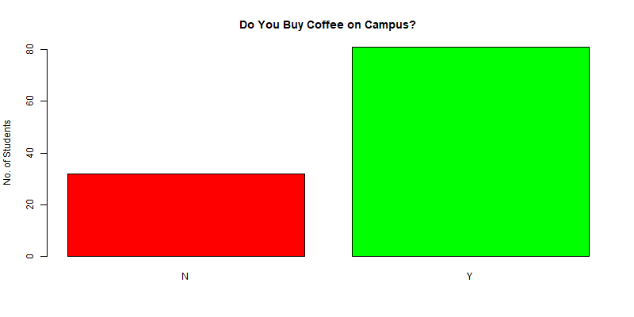

Slide 5
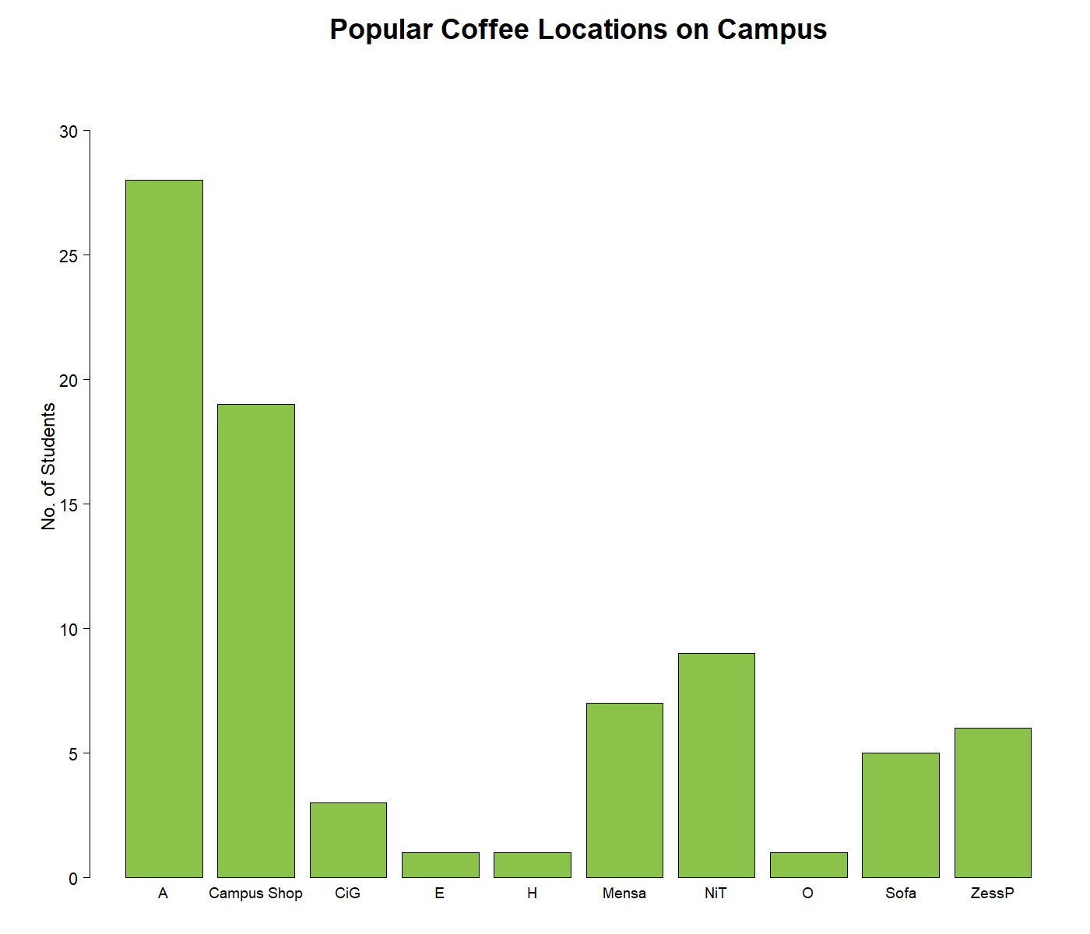

Slide 6
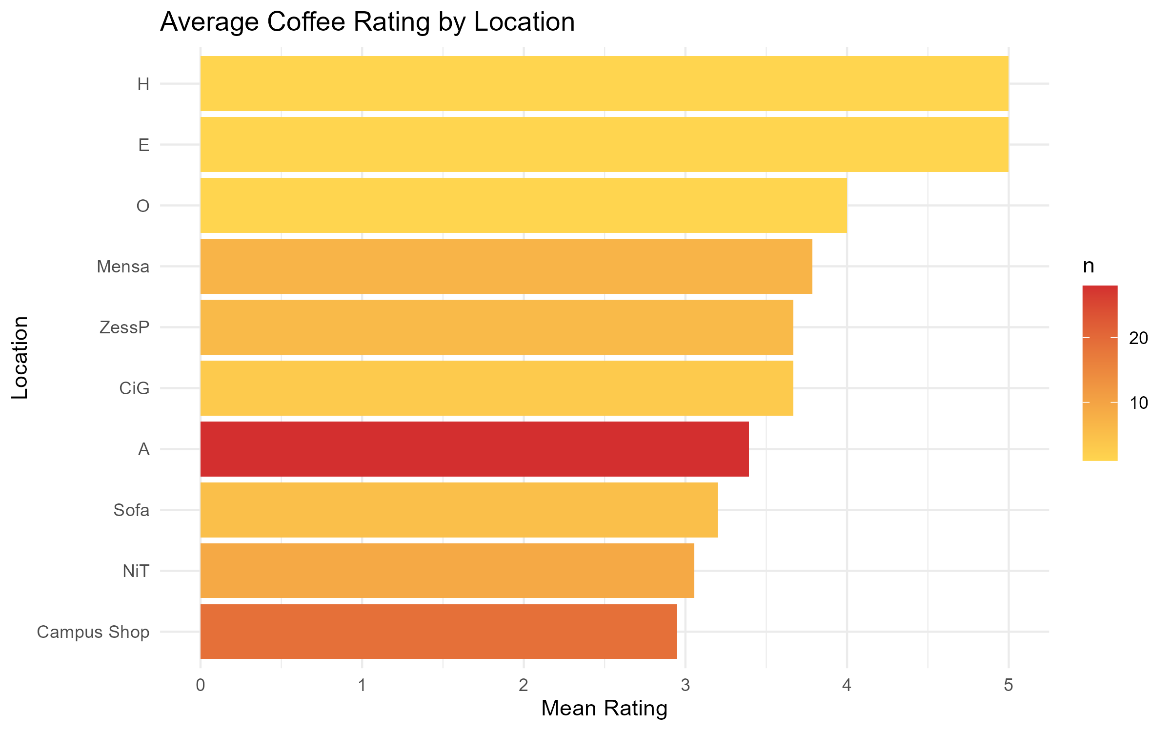

Slide 7
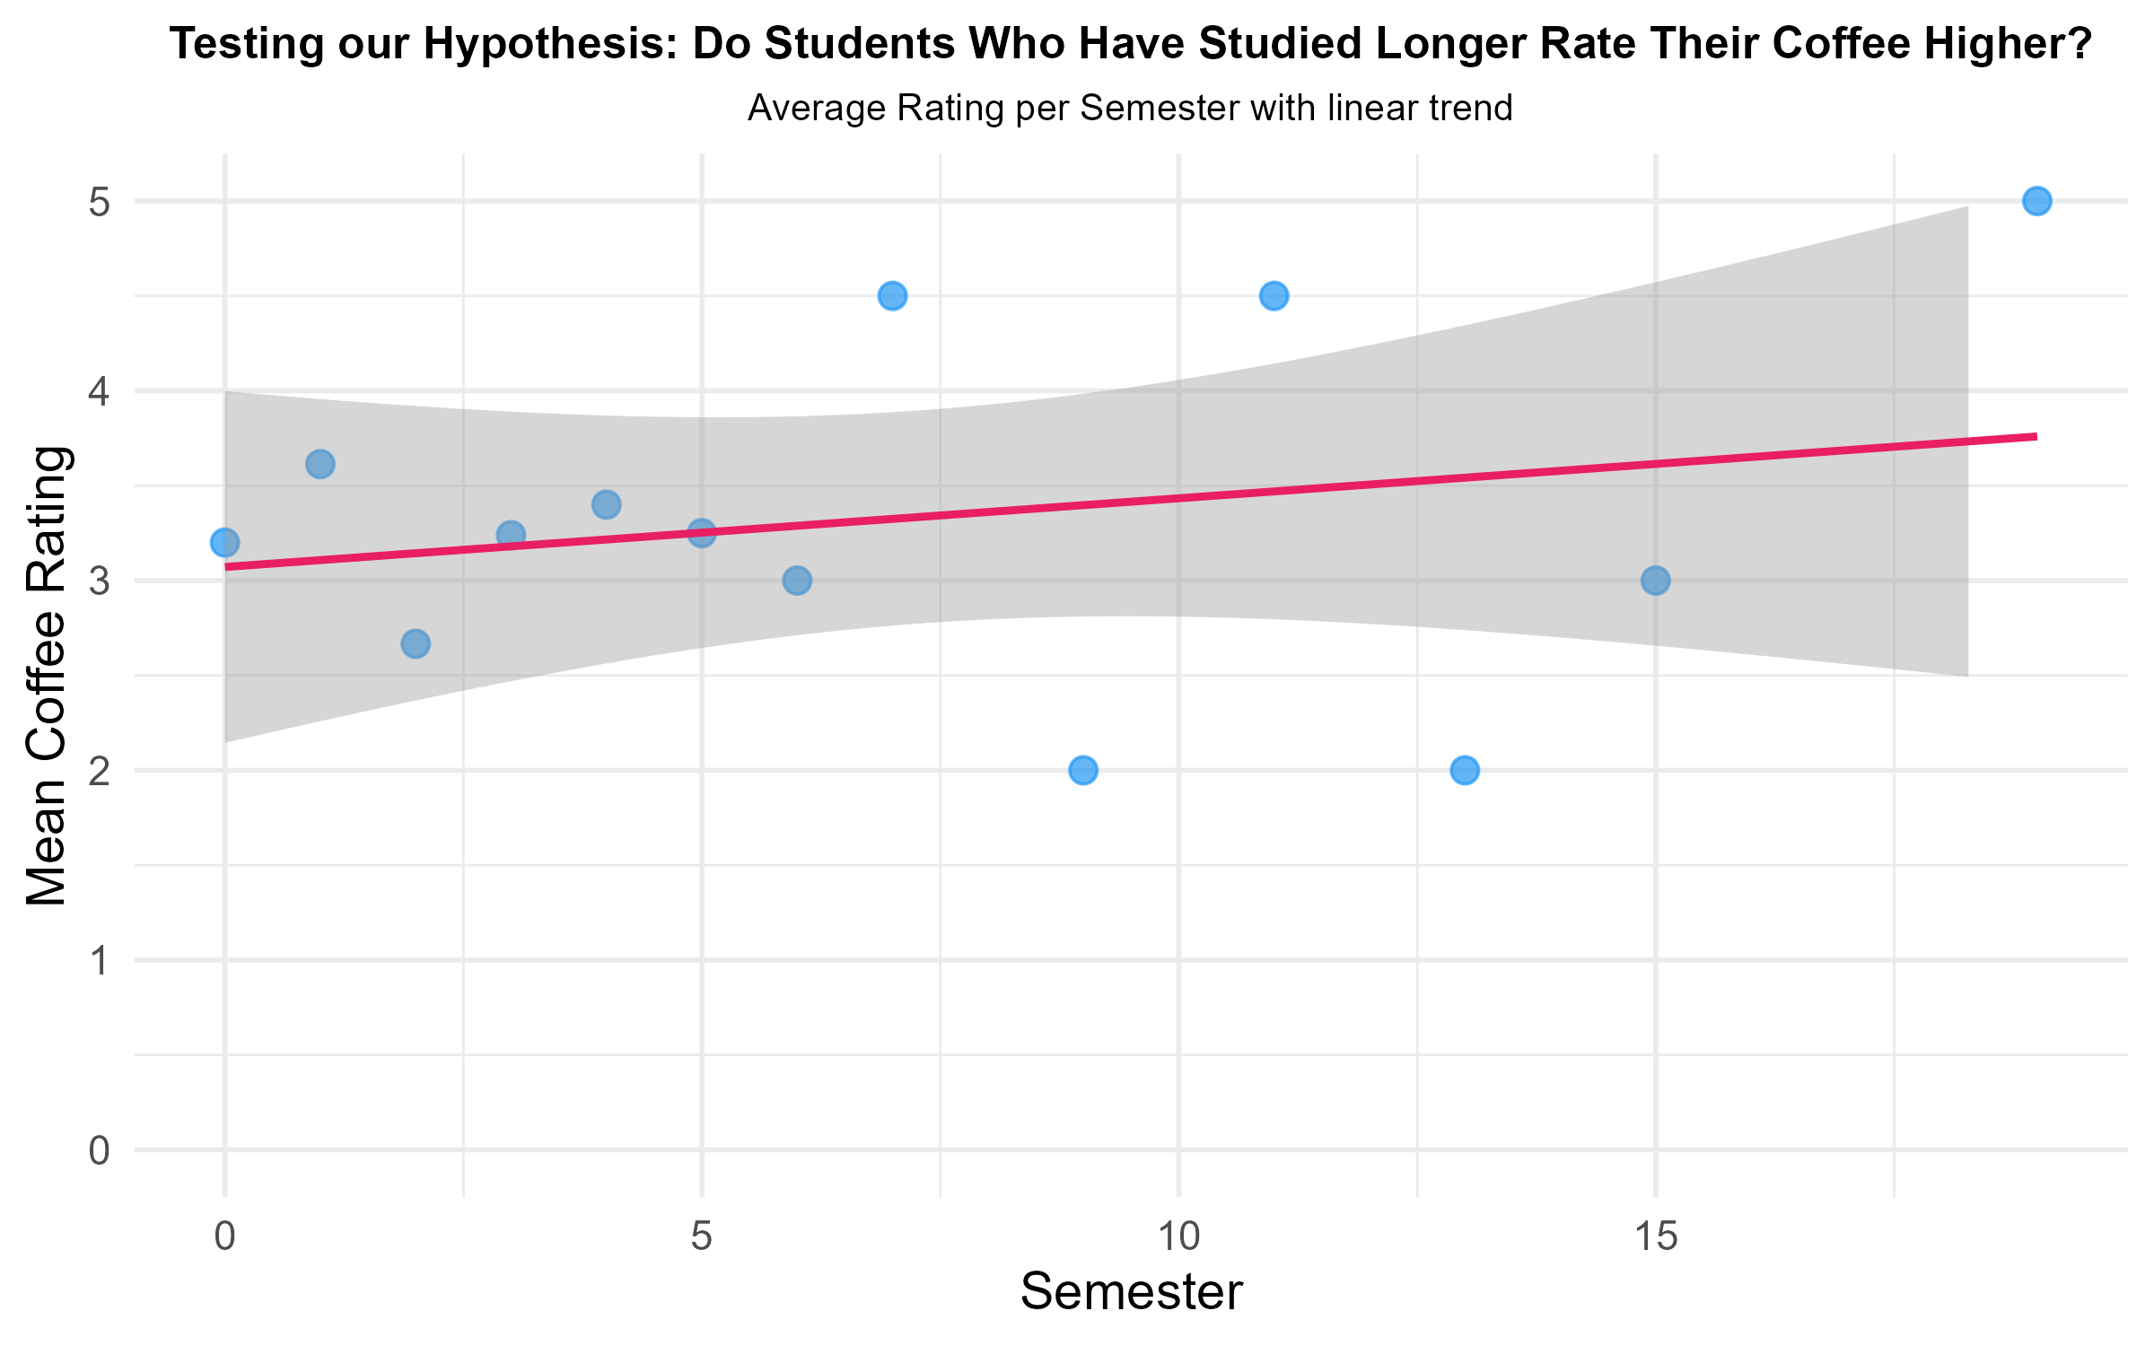

Slide 8


THANK YOU

Slide 9
Bonus Stats

Slide 10
